Slide 1
Processor Architecture
60080013: Computer Organization
4th Lecture
Instructors:
Sun Heng

Slide 2
Processor Architecture
  Modern microprocessors are among the most complex systems ever created by humans. The instructions supported by a particular processor and their byte-level encodings are known as its instruction-set architecture (ISA). In this chapter, we take a brief look at the design of processor hardware. We start by defining a simple instruction set. We call this the “Y86-64” instruction set. Compared with x86-64, the Y86-64 instruction set has fewer data types, instructions, and addressing modes. It also has a simpler bytelevel encoding. Still, it is sufficiently complete to allow us to write simple programs manipulating integer data.

Slide 3
Y86-64 Processor State
RF: Program registers
CC: Condition codes
Stat: Program status
%rax
%rsp
%r8
%r12
%rcx
%rbp
%r9
%r13
ZF
SF
OF
DMEM: Memory
%rdx
%rsi
%r10
%r14
PC
%rbx
%rdi
%r11
  Program Registers
    15 registers (omit %r15). Each 64 bits
  Condition Codes
    Single-bit flags set by arithmetic or logical instructions
      ZF: Zero SF:Negative OF: Overflow
  Program Counter
    Indicates address of next instruction
  Program Status
    Indicates either normal operation or some error condition
  Memory
    Byte-addressable storage array
    Words stored in little-endian byte order

Slide 4
Y86-64 Instruction Set #1
Byte
0
1
2
3
4
5
6
7
8
9
halt
0
0
nop
1
0
cmovXX rA, rB
2
fn
rA
rB
irmovq V, rB
3
0
F
rB
V
rmmovq rA, D(rB)
4
0
rA
rB
D
mrmovq D(rB), rA
5
0
rA
rB
D
OPq rA, rB
6
fn
rA
rB
jXX Dest
7
fn
Dest
call Dest
8
0
Dest
ret
9
0
pushq rA
A
0
rA
F
popq rA
B
0
rA
F

Slide 5
Y86-64 Instruction Set #2
Byte
0
1
2
3
4
5
6
7
8
9
rrmovq
halt
0
0
2
0
cmovle
nop
1
0
2
1
cmovl
cmovXX rA, rB
2
fn
rA
rB
2
2
cmove
irmovq V, rB
3
0
F
rB
V
2
3
cmovne
rmmovq rA, D(rB)
4
0
rA
rB
D
2
4
cmovge
mrmovq D(rB), rA
5
0
rA
rB
D
2
5
cmovg
OPq rA, rB
6
fn
rA
rB
2
6
jXX Dest
7
fn
Dest
call Dest
8
0
Dest
ret
9
0
pushq rA
A
0
rA
F
popq rA
B
0
rA
F

Slide 6
Y86-64 Instruction Set #3
Byte
0
1
2
3
4
5
6
7
8
9
halt
0
0
nop
1
0
cmovXX rA, rB
2
fn
rA
rB
irmovq V, rB
3
0
F
rB
V
rmmovq rA, D(rB)
4
0
rA
rB
D
addq
6
0
mrmovq D(rB), rA
5
0
rA
rB
D
subq
6
1
OPq rA, rB
6
fn
rA
rB
andq
6
2
jXX Dest
7
fn
Dest
xorq
6
3
call Dest
8
0
Dest
ret
9
0
pushq rA
A
0
rA
F
popq rA
B
0
rA
F

Slide 7
Y86-64 Instruction Set #4
6
7
8
jmp
9
Byte
0
1
2
3
4
5
7
0
halt
0
0
jle
7
1
nop
1
0
jl
7
2
cmovXX rA, rB
2
fn
rA
rB
je
7
3
irmovq V, rB
3
0
F
rB
V
jne
7
4
rmmovq rA, D(rB)
4
0
rA
rB
D
jge
7
5
mrmovq D(rB), rA
5
0
rA
rB
D
jg
7
6
OPq rA, rB
6
fn
rA
rB
jXX Dest
7
fn
Dest
call Dest
8
0
Dest
ret
9
0
pushq rA
A
0
rA
F
popq rA
B
0
rA
F

Slide 8
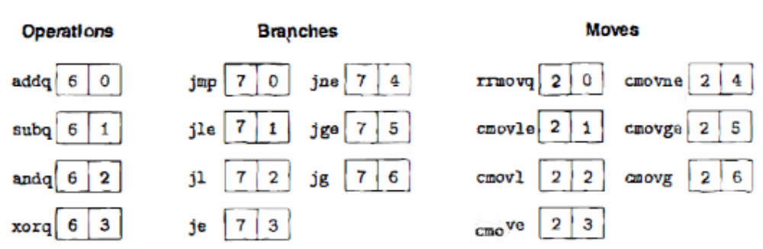
Y86-64 Instructions
Format
  1–10 bytes of information read from memory
    Can determine instruction length from first byte
    Not as many instruction types, and simpler encoding than with x86-64
  Each accesses and modifies some part(s) of the program state

Slide 9
Encoding Registers
Each register has 4-bit ID
  Same encoding as in x86-64
Register ID 15 (0xF) indicates “no register”
  Will use this in our hardware design in multiple places
%rax
0
%r8
8
%rcx
1
%r9
9
%rdx
2
%r10
A
%rbx
3
%r11
B
%rsp
4
%r12
C
%rbp
5
%r13
D
%rsi
6
%r14
E
%rdi
7
No Register
F

Slide 10
Y86-64 Little-endian Encoding
As with x86-64, all integers have a little-endian encoding. When the instruction is written in disassembled form, these bytes appear in reverse order.
Question:
    What’s byte encoding in hexadecimal of the instruction rmmovq %rsp,0x123456789abcd(%rdx)?
Answer:
    4042cdab896745230100

Slide 11
Instruction Decoding
Optional
Optional
5
0
rA
rB
D
icode
ifun
rA
rB
valC
Instruction Format
  Instruction byte icode:ifun
  Optional register byte rA:rB
  Optional constant word valC

Slide 12
Classwork
Problem 4.1

Slide 13
Digital Signals
0
1
0
Voltage
Time
  Use voltage thresholds to extract discrete values from continuous signal
  Simplest version: 1-bit signal
    Either high range (1) or low range (0)
    With guard range between them
  Not strongly affected by noise or low quality circuit elements
    Can make circuits simple, small, and fast

Slide 14
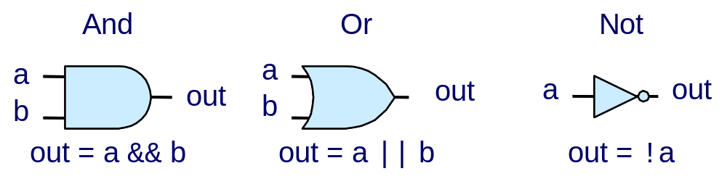
Computing with Logic Gates
  Outputs are Boolean functions of inputs
  Respond continuously to changes in inputs
    With some, small delay
Rising Delay
Falling Delay
a && b
b
Voltage
a
Time

Slide 15
Combinational Circuits
By assembling a number of logic gates into a network, we can construct computational blocks known as combinational circuits. Several restrictions are placed on how the networks are constructed
  Every logic gate input must be connected to exactly one of the following: (1) one of the system inputs (known as a primary input), (2) the output connection of some memory element, or (3) the output of some logic gate.
  The outputs of two or more logic gates cannot be connected together. Otherwise, the two could try to drive the wire toward different voltages, possibly causing an invalid voltage or a circuit malfunction.
  The network must be acyclic. That is, there cannot be a path through a series of gates that forms a loop in the network. Such loops can cause ambiguity in the function computed by the network.

Slide 16



Combinational Circuits
Acyclic Network
Primary
Inputs
Primary
Outputs
Acyclic Network of Logic Gates
  Continously responds to changes on primary inputs
  Primary outputs become (after some delay) Boolean functions of primary inputs

Slide 17
Bit Equality
Bit equal
a
HCL Expression
eq
bool eq = (a&&b)||(!a&&!b)
b
  Generate 1 if a and b are equal
Hardware Control Language (HCL)
  Very simple hardware description language
    Boolean operations have syntax similar to C logical operations
  We’ll use it to describe control logic for processors

Slide 18
Word Equality
Word-Level Representation
b₆₃
Bit equal
eq₆₃
B
=
Eq
a₆₃
b₆₂
Bit equal
eq₆₂
A
a₆₂
HCL Representation
Eq
bool Eq = (A == B)
b₁
Bit equal
eq₁
a₁
  64-bit word size
  HCL representation
    Equality operation
    Generates Boolean value
b₀
Bit equal
eq₀
a₀

Slide 19
Arithmetic Logic Unit
0
1
2
3
Y
A
Y
A
Y
A
Y
A
A
L
U
A
L
U
A
L
U
A
L
U
X + Y
X - Y
X & Y
X ^ Y
X
B
OF
X
B
OF
X
B
OF
X
B
OF
ZF
ZF
ZF
ZF
SF
SF
SF
SF
  Combinational logic
    Continuously responding to inputs
  Control signal selects function computed
    Corresponding to 4 arithmetic/logical operations in Y86-64
  Also computes values for condition codes

Slide 20
Sequential Circuits
  Combinational circuits, by their very nature, do not store any information. Instead, they simply react to the signals at their inputs, generating outputs equal to some function of the inputs. To create sequential circuits—that is, systems that have state and perform computations on that state—we must introduce devices that store information represented as bits. Our storage devices are all controlled by a single clock, a periodic signal that determines when new values are to be loaded into the devices.

Slide 21
Register Operation
State = x
State = y
x
Rising
clock
y
Input = y
Output = x


Output = y
  Stores data bits
  For most of time acts as barrier between input and output
  As clock rises, loads input

Slide 22
Register File
valA
Register
file
srcA
A
valW
Read ports
W
dstW
Write port
valB
srcB
B
Clock
  Stores multiple words of memory
    Address input specifies which word to read or write
  Register file
    Holds values of program registers
    %rax, %rsp, etc.
    Register identifier serves as address
      ID 15 (0xF) implies no read or write performed
  Multiple Ports
    Can read and/or write multiple words in one cycle
      Each has separate address and data input/output

Slide 23
Register File Timing
Reading
  Like combinational logic
  Output data generated based on input address
    After some delay
Writing
  Like register
  Update only as clock rises
valA
Register
file
2
x
srcA
A
x
valB
srcB
B
2
Register
file
2
x
Register
file
2
y
valW
y
Rising
clock


valW
W
dstW
2
W
dstW
Clock
Clock

Slide 24
SEQ Stages
newPC
PC
valE
,
valM
Write back
valM
Fetch
  Read instruction from instruction memory
Decode
  Read program registers
Execute
  Compute value or address
Memory
  Read or write data
Write Back
  Write program registers
PC
  Update program counter
Data
Memory
Data
memory
memory
Addr
, Data
valE
CC
CC
ALU
Execute
Cnd
ALU
aluA
,
aluB
valA
,
valB
Decode
srcA
,
srcB
A
A
B
dstA
,
dstB
B
M
Register
M
Register
Register
Register
file
file
file
file
E
E
icode
,
ifun
valP
rA
,
rB
valC
Instruction
PC
Instruction
PC
Fetch
memory
increment
memory
increment
PC

Slide 25
Executing Arith./Logical Operation
OPq rA, rB
6
fn
rA
rB
Fetch
  Read 2 bytes
Decode
  Read operand registers
Execute
  Perform operation
  Set condition codes
Memory
  Do nothing
Write back
  Update register
PC Update
  Increment PC by 2

Slide 26
Stage Computation: Arith/Log. Ops
OPq rA, rB
Fetch
icode:ifun ← M₁[PC]
Read instruction byte
rA:rB ← M₁[PC+1]
Read register byte
valP ← PC+2
Compute next PC
Decode
valA ← R[rA]
Read operand A
valB ← R[rB]
Read operand B
Execute
valE ← valB OP valA
Perform ALU operation
Set CC
Set condition code register
Memory
Write
back
R[rB] ← valE
Write back result
PC update
PC ← valP
Update PC
  Formulate instruction execution as sequence of simple steps
  Use same general form for all instructions

Slide 27


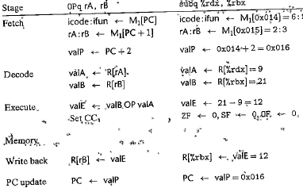


Computations for the Specific Instruction
For the subtract instruction in the following code:
Operation stages:

Slide 28
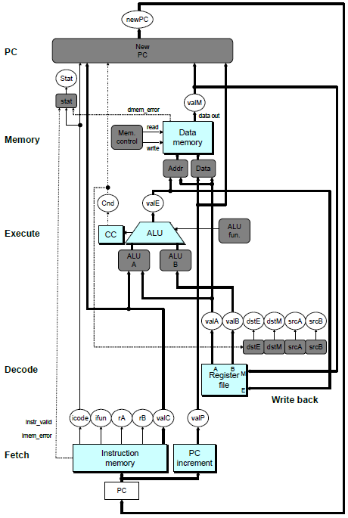
SEQ Hardware
Key
  Blue boxes: predesigned hardware blocks
    E.g., memories, ALU
  Gray boxes: control logic
    Describe in HCL
  White ovals: labels for signals
  Thick lines: 64-bit word values
  Thin lines: 4-8 bit values
  Dotted lines: 1-bit values
硬件控制语言的实现逻辑

Slide 29
Computed Values
Fetch
  icode Instruction code
  ifun Instruction function
  rA Instr. Register A
  rB Instr. Register B
  valC Instruction constant
  valP Incremented PC
Decode
  srcA Register ID A
  srcB Register ID B
  dstE Destination Register E
  dstM Destination Register M
  valA Register value A
  valB Register value B
Execute
  valE ALU result
  Cnd Branch/move flag
Memory
  valM Value from memory

Slide 30

Fetch Logic
icode
ifun
rA
rB
valC
valP
Need
valC
PC
increment
Instr
valid
Need
regids
icode
ifun
Split取出第一个字节，分开高四位和低四位
Split
Align
Byte 0
Bytes 1-9
Instruction
memory
imem_error
Predefined Blocks
  PC: Register containing PC
  Instruction memory: Read 10 bytes (PC to PC+9)
    Signal invalid address
  Split: Divide instruction byte into icode and ifun
  Align: Get fields for rA, rB, and valC
PC
Y86中指令长度为1-10，所以一次取出十个字节

Slide 31
Fetch Logic
icode
ifun
rA
rB
valC
valP
Valp = p + 1 + r + i*8
Need
valC
PC
increment
Instr
valid
Need
regids
Step1：读icode是否在0~B
icode
ifun
step2：是否需要register（是否为1）
Split
Align
Step3：如为1，取出第二个字节来，分为高四位低四位。剩下的八个字节给译码部件
Byte 0
Bytes 1-9
Instruction
memory
imem_error
Control Logic
  Instr. Valid: Is this instruction valid?
  Need regids: Does this instruction have a register byte?
  Need valC: Does this instruction have a constant word?
PC

Slide 32
Fetch Control Logic in HCL
halt
0
0
nop
1
0
cmovXX rA, rB
2
fn
rA
rB
irmovq V, rB
3
0
F
rB
V
rmmovq rA, D(rB)
4
0
rA
rB
D
mrmovq D(rB), rA
5
0
rA
rB
D
OPq rA, rB
6
fn
rA
rB
jXX Dest
7
fn
Dest
call Dest
8
0
Dest
ret
9
0
pushq rA
A
0
rA
F
popq rA
B
0
rA
F
bool need_regids =
icode in { IRRMOVQ, IOPQ, IPUSHQ, IPOPQ,
IIRMOVQ, IRMMOVQ, IMRMOVQ };
bool instr_valid = icode in
{ INOP, IHALT, IRRMOVQ, IIRMOVQ, IRMMOVQ, IMRMOVQ,
IOPQ, IJXX, ICALL, IRET, IPUSHQ, IPOPQ };

Slide 33
Decode Logic
译码：从寄存器把值读出来or把值写进寄存器
Register File
  Read ports A, B
  Write ports E, M
  Addresses are register IDs or 15 (0xF) (no access)
ValE: 来自于ALU
Cnd
valA
valB
valM
valE
A
B
Register
file
M
dstE
dstM
srcA
E
srcB
Control Logic
  srcA, srcB: read port addresses
  dstE, dstM: write port addresses
dstE
dstM
srcA
srcB
icode
rA
rB
Signals
  Cnd: Indicate whether or not to perform conditional move
    Computed in Execute stage

Slide 34
A Source
OPq rA, rB
Decode
valA ← R[rA]
Read operand A
cmovXX rA, rB
Decode
valA ← R[rA]
Read operand A
rmmovq rA, D(rB)
Decode
valA ← R[rA]
Read operand A
popq rA
Decode
valA ← R[%rsp]
Read stack pointer
jXX Dest
Decode
No operand
call Dest
Decode
No operand
ret
Decode
valA ← R[%rsp]
Read stack pointer
int srcA = [
icode in { IRRMOVQ, IRMMOVQ, IOPQ, IPUSHQ } : rA;
icode in { IPOPQ, IRET } : RRSP;
1 : RNONE; # Don't need register
];
从内存的栈里面取出栈顶的地址
从寄存器RSP里面读数据

Slide 35
E
Destination
OPq rA, rB
Write-back
R[rB] ← valE
Write back result
cmovXX rA, rB
Conditionally write back result
Write-back
R[rB] ← valE
rmmovq rA, D(rB)
Write-back
None
popq rA
Write-back
R[%rsp] ← valE
Update stack pointer
jXX Dest
Write-back
None
call Dest
Write-back
R[%rsp] ← valE
Update stack pointer
ret
Write-back
R[%rsp] ← valE
Update stack pointer
int dstE = [
icode in { IRRMOVQ } && Cnd : rB;
icode in { IIRMOVQ, IOPQ} : rB;
icode in { IPUSHQ, IPOPQ, ICALL, IRET } : RRSP;
1 : RNONE; # Don't write any register
];

Slide 36
Execute Logic
Units
  ALU
    Implements 4 required functions
    Generates condition code values
  CC
    Register with 3 condition code bits
  cond
    Computes conditional jump/move flag
Control Logic
  Set CC: Should condition code register be loaded?
  ALU A: Input A to ALU
  ALU B: Input B to ALU
  ALU fun: What function should ALU compute?
Cnd
valE
cond
ALU
ALU
fun.
CC
Set
CC
ALU
A
ALU
B
icode
ifun
valC
valA
valB

Slide 37
ALU A
Input
OPq rA, rB
Execute
valE ← valB OP valA
Perform ALU operation
cmovXX rA, rB
Execute
valE ← 0 + valA
Pass valA through ALU
rmmovq rA, D(rB)
Execute
valE ← valB + valC
Compute effective address
popq rA
Execute
valE ← valB + 8
Increment stack pointer
jXX Dest
Execute
No operation
call Dest
Execute
valE ← valB + –8
Decrement stack pointer
ret
Execute
valE ← valB + 8
Increment stack pointer
int aluA = [
icode in { IRRMOVQ, IOPQ } : valA;
icode in { IIRMOVQ, IRMMOVQ, IMRMOVQ } : valC;
icode in { ICALL, IPUSHQ } : -8;
icode in { IRET, IPOPQ } : 8;
# Other instructions don't need ALU
];

Slide 38
ALU
Operation
OPl rA, rB
Execute
valE ← valB OP valA
Perform ALU operation
cmovXX rA, rB
Execute
valE ← 0 + valA
Pass valA through ALU
rmmovl rA, D(rB)
Execute
valE ← valB + valC
Compute effective address
popq rA
Execute
valE ← valB + 8
Increment stack pointer
jXX Dest
Execute
No operation
call Dest
Execute
valE ← valB + –8
Decrement stack pointer
ret
Execute
valE ← valB + 8
Increment stack pointer
int alufun = [
icode == IOPQ : ifun;
1 : ALUADD;
];

Slide 39
Memory Logic
Memory
  Reads or writes memory word
Control Logic
  stat: What is instruction status?
  Mem. read: should word be read?
  Mem. write: should word be written?
  Mem. addr.: Select address
  Mem. data.: Select data
Stat
ValM:value from memory
stat
valM
dmem_error
data out
instr_valid
Mem.
read
read
Data
memory
imem_error
Mem.
write
write
data in
Mem.
addr
Mem.
data
icode
valE
valA
valP

Slide 40
PC Update Logic
PC
New PC
  Select next value of PC
New
PC
icode
Cnd
valC
valM
valP
五大过程图挑其中一个来进行解释：对所有的缩写标进行解读：1.关联；2.功能 Fetch和decode比较复杂 不太考

Slide 41
Classwork
Problem 4.13

